Slide 1
Intra Industry Trade
Dr. Anwesha Aditya
IIT Kharagpur

Slide 2
Intra-industry Trade (IIT):
Trade between similar countries in similar products.
Sources of IIT:
Market imperfection
IRS
Product differentiation

Slide 3
Types of Intra-industry Trade
Intra-Industry Trade (IIT)
IIT in Identical Commodities IIT in Differentiated Products
Border Trade
Strategic Trade
(e.g., Brander, 1981, Spencer, Krugman)
Horizontal Differentiation Vertical Differentiation
Love of Variety approach (by Krugman, 1979 Trade in Quality differentiated goods
Based on Dixit-Stiglitz utility function (Helpman, E. Bond)
Characteristic approach
(by Helpman based on
Lancester’s utlity function)

Slide 4
IIT in identical product: Border Trade
Assumptions:
Transport cost increases with distance.
Free trade between countries.
Conditions:
Common border
Geographically large countries
Example: Trade between US & Canada
C
A
B

Slide 5
IIT in Horizontally Differentiated products: Characteristic Approach
Developed by Helpman (1980) based on Lancaster (1979).
Feature of Characteristic Approach:
Heterogeneous consumers (in terms of taste/preference).
IRS
Product differentiation
Goods are viewed as bundle of characteristics.
Every individual has a notion of ideal package.
If you get your “ideal” you are lucky, otherwise go for the next best alternative.
Under autarky, number of variety available may be < number of ideal packages.

Slide 6
Circular City and Distribution of Preferences
Consumers are uniformly distributed among the circumference of the unit circle. Each point represents a consumer. In HC 4 varieties are produced- m1, m2, m3, m4.
C₁
Consider identical FC producing 4 models- m1*, m2*, m3*, m4*.
m*₁
m₁
m*₂
C3
m₃
m₄
C4
The models are different but there is no price difference.
m*₄
m2
m*₃
C₂

Slide 7
Gains from trade occurs
In each country the availability of ideal package increases.
There will be some takers of the 4 Home varieties in both HC and FC.
There will be some takers of the 4 Foreign varieties in both HC and FC.

Slide 8
IIT in horizontally differentiated products
Love for Variety Approach, Monopolistic Competition and IIT, Krugman, 1979
IRS (implication: each variety is produced by only one firm)
Product differentiation (horizontal)
Identical consumers (unlike Characteristic approach)

Slide 9
Preference
Variety per se doesn’t matter. Hence, different varieties enter the utility function symmetrically.
Dixit-Stiglitz preference function
(1) U = v(c₁) + v(c₂)+ v(c₃)+ ……+ v(c_{n} ) , v′ (c_{i}) > 0, v′′ ( c_{i}) < 0

Slide 10


Assumptions regarding demand function
Define price elasticity of demand: $ε_{i}=−\frac{v′(c_{i})}{v′′(c_{i})c_{i}}$
FOC: MU/P=λ
$$\frac{δU}{δC_{i}}=v′(c_{i})=λP_{i}$$
$$v′′(c_{i})=λ\frac{δP_{i}}{δC_{i}}$$
Define price elasticity of demand: $ε_{i}=−\frac{P_{i}}{c_{i}}\frac{δC_{i}}{δP_{i}}$
2. Assumption: downward sloping linear demand curve
$$\frac{δε_{i}}{δc_{i}}<0$$

Slide 11
Assumptions regarding Production function
Labour is the only factor of production.
3. Production function:
where x_{i} is the total output of i-th variety,
l_{i} is the amount of labour required to produce x_{i} unit of i-th variety;
α Is the fixed labour cost, β is the fixed labour cost.
Equilibrium under autarchy for each variety:
Identical consumers each of them consume c_{i}
where L = number of workers as well as the total number of consumers in the Home country
Hence n=L/l

Slide 12
Assumptions of Monopolistic competition
4. Given IRS each variety will be produced by a single firm. Therefore, each firm has monopoly power over its own brand. (Assmpn of monopoly in monopolistic competition)
Hence number of firm = number of variety = n
5. Varieties are close substitutes. Hence monopoly power is not exerted much. Due to free entry and exit, at the LR eqm, profits=0.
(Assmpn of perfect competition in monopolistic competition)

Slide 13
Equilibrium conditions
Under monopolistic competition: MR=MC
=
⇒
………………………..Condition (A)
Free entry of firms => P=AC=>
………………………..Condition (B)
⇒
Two endogenous variables c and w/p to be solved from 2 eqns.

Slide 14
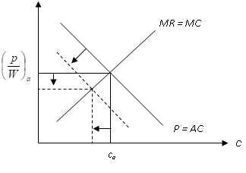
Effect of Trade on Real Wage and Consumption

Slide 15
Equilibrium conditions
MR=MC is positively sloped: As c rises, elasticity of dd falls (for a linear demand function). Denominator of (A) falls. So RHS rises, (P/W) should increase to maintain equality.
P=AC is downward sloping. As C rises, xrises, (1/x) falls, RHS falls, (P/W) should increase to maintain equality.
Number of varieties produced under autarchy in Home country is:

Slide 16
Post Trade
Given the type of the utility function and identical consumers, opening up of trade implies increase in the number of consumer for each producer (equivalent to growth in labour force).
Suppose FC produces n* no of varieties.
Due to IRS, all n and n* varieties are distinctly different.
As L increases (when trade opens up), dd increases, output per variety (in both HC and FC) increases. Hence P=AC shifts down but MR=MC remains unchanged.

Slide 17
Gains from trade:
Increase in real wage: Labour being the only factor of production implies real income gain.
P falls: Larger integrated market allows each firm to expand their production and thus lower AC. With free entry P=AC, price of each variety thus falls.
Money wage increases: Increase in output requires more labour, which given the labour supply, raises the money wage in each country.
since price falls and nominal wage increases, real wage goes up implying real income gain.
2. Increase in number of variety: Though consumption per variety falls, this loss is offset by increase in number of varities available in each country.

Slide 18


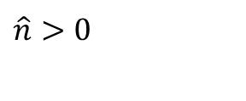
Increase in number of variety
Now n = L/βx
⇒
$$\hat{n}=\hat{L}−\hat{x}>0$$
Since
$$\hat{x}=\hat{L}+\hat{c}$$
As L increases, C falls, x increases but < the increase in L.
Hence
$$\hat{n}>0$$

Slide 19
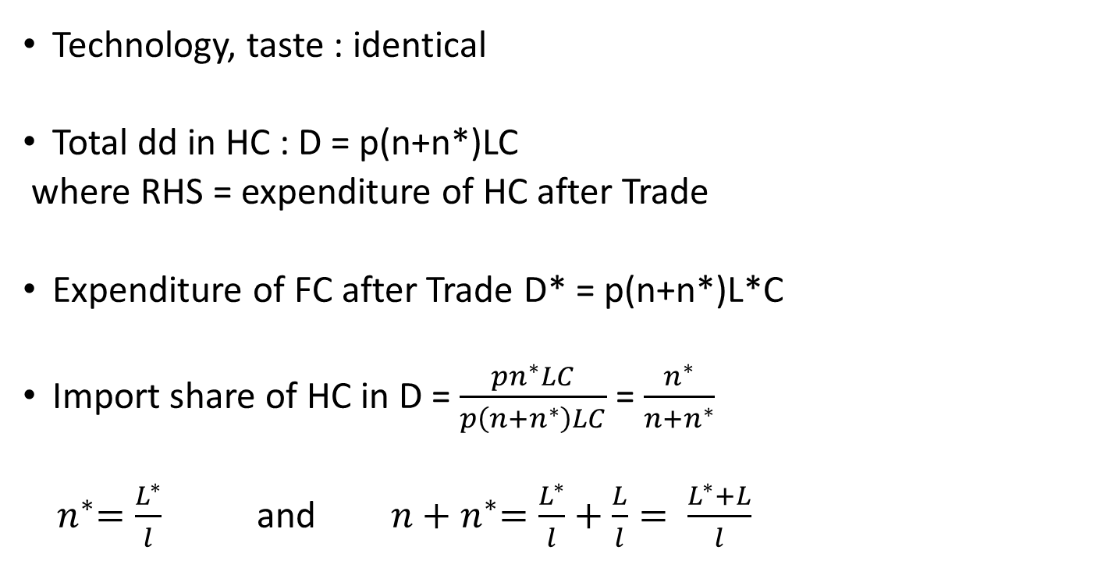
FPE in Krugman’s done for variety (1979)
Technology, taste : identical
Total dd in HC : D = p(n+n*)LC
where RHS = expenditure of HC after Trade
Expenditure of FC after Trade D* = p(n+n*)L*C
Import share of HC in D = $\frac{pn^{∗}LC}{p\left(n+n^{∗}\right)LC}$ = $\frac{n^{∗}}{n+n^{∗}}$
${ n}^{∗}=\frac{L^{∗}}{l}$ and ${ n+n}^{∗}=\frac{L^{∗}}{l}+\frac{L}{l}= \frac{L^{∗}+L}{l}$

Slide 20
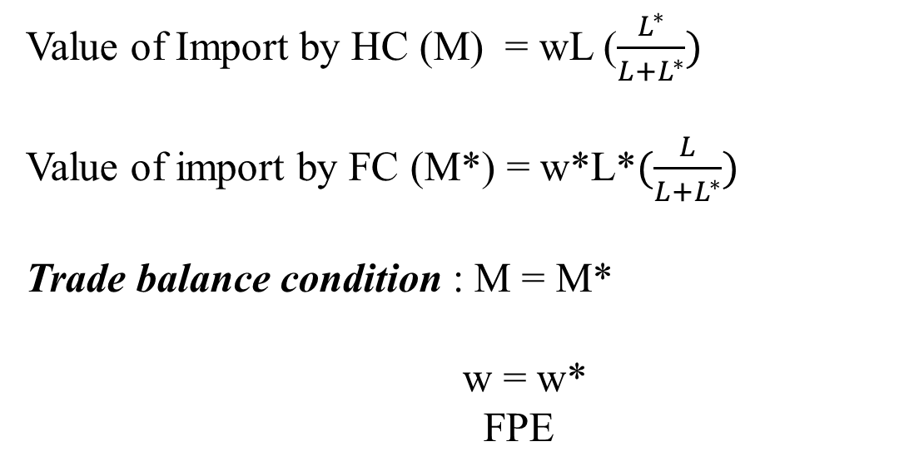
Value of Import by HC (M) = wL ($\frac{L^{∗}}{L+L^{∗}})$
Value of import by FC (M*) = w*L*$(\frac{L}{L+L^{∗}})$
Trade balance condition : M = M*
w = w*
FPE

Slide 21
Limitation of the Model
Pattern of trade is indeterminate.
We don’t know in the post-trade situation which varieties are exported by which countries in the Love-of-Variety and Characteristic approach. Hence implementation of trade policy becomes difficult.

Slide 22
Distinction between Love-of-Variety and Characteristic Approach
Love-of-variety is applicable for non-durable goods which the consumers can buy a lot whereas Characteristic approach is more suited for durable goods.
In Love-of-variety consumer preference is homogeneous whereas in Characteristic approach the notion of ideal variety differs across consumers implying that consumers preference is heterogenous.

Slide 23
IIT in identical product: Reciprocal dumping (Brander, 1981)
The source or basis of trade here is the market imperfection.
Homogenous product
CRS
Monopoly under autarky

Slide 24
Let demand and cost conditions are identical in the two countries:
Pa=Pa*=Pm
Hence autarkic profits of the two countries are equal (to monopoly profit).
Autarkic price of HF (Home Firm)> MC. Hence FF (Foreign Firm) can enter the Home market and charge a price < Pm.
Similarly, HF can invade Foreign market.
Hence post-trade duopoly. (Assume Cournot competition, that is, simultaneous move output competition )
Pm>Pd>c (Note. Pd>c for all non-Bertrand equilibrium)

Slide 25
Market Structure
Domestic monopoly under autarky.
Post-trade Cournot competition
Note the result will hold even if we assume oligopoly under autarky. In that case when trade opens up market structure will still be oligopoly with increased number of firms.

Slide 26
Two important assumptions
Market symmetry: Identical technology and identical local demand conditions imply same pre-trade relative prices ruling out the scope for arbitrage.
Market segmentation: Because of constant marginal cost of production output decision in one market does not depend on output decisions in other markets.
Since MC doesn’t depend on output volumes of exports as well as domestic sales are to be decided by the firm. Hence the two decisions of how much a firm will be selling domestically and how much in abroad are independent of each other.
(Note that with increasing or decreasing MC, the property of market segmentation will not hold)

Slide 27
Pay-off matrix
Foreign Firm
Enter
Not Enter
2πd,2πd
Πm+πd,πd
Enter
Home Firm
Not Enter
πd,πd+πm
πm,πm
Nash Equilibrium: (Enter, Enter) for any πd>0
Notes:
92

Slide 28
Remarks.
Basis of trade here is market imperfection. If we assume perfect competition so that P=MC in both the countries, then there would not have been any incentive of evasion.
Here we assume fixed cost=0, MC= constant. Hence production technology exhibits CRS. So economies of scale is not the basis of trade in strategic trade theory.
This is called cross-hauling or reciprocal dumping. Since autarkic prices are > MC Each country can dump (charge a lower price) its product on the foreign market.

Slide 29
Model
Demand functions:
P_{h}=f(X_{h}) where Xh=x_{h}+x_{h}*
P_{f}=f(X_{f}) where Xf=x_{f}+x_{f}*
Cost function: C=cX= Cx_{h} +Cx_{f}
Profit of Home and Foreign firms :
Π=[P_{h} - c] Xh +[P_{f} -c] Xf
Π*=[P_{h} - c] Xh* +[P_{f} -c] Xf*

Slide 30
First order conditions:
These will be independent pairs.
So are related through demand. Xh doesn’t depend on Xf. Xf doesn’t depend on Xh.

Slide 31
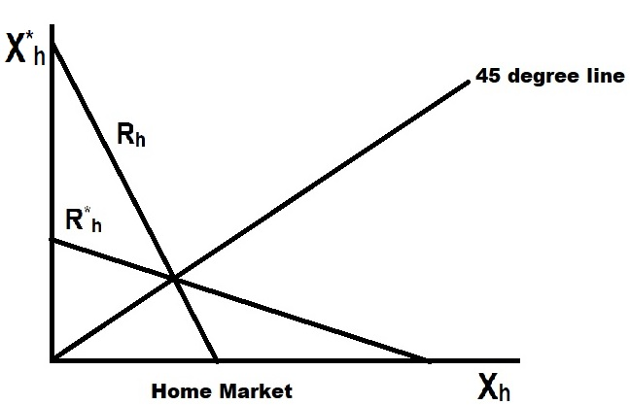

Slide 32
Price
D_{I}
a
P_{Ia}
d
b
P_{I f}
c
MC
e g h
O
Computers
X_{f} X_{a}
MR
Domestic Market, Reciprocal Dumping and IIT

Slide 33
Gains from Trade: Welfare Analysis
CS increases from the area aD_{I}P_{Ia} to bD_{Ia}P_{If} as Price falls by the pro-competitive effect of trade.
Profit of domestic firm changes from aP_{Ia}cg to dP_{If} ce from local sales and dehb from exports.
Area dP_{If} ce measures the profit for the foreign firm from selling in its domestic market.
Net increase in total surplus for both countries. CS and profit increases.

Slide 34
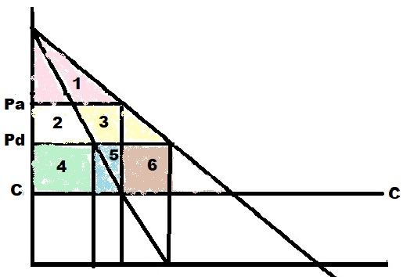
W_{a} = CS_{a} + π_{a}
= area (1+2+4+5)
W_{T} = CS_{T} + π_{T}
= areas (1+2+3) + areas (4+5+6)
Therefore,
GFT = areas (3+6)

Slide 35
Distinction between Strategic Trade Model with Love-of-Variety and Characteristic Approach
Love-of-variety and Characteristic approach assume IRS but Strategic trade model has CRS.
Love-of-variety and Characteristic approach deal with differentiated product whereas Strategic trade model has homogenous product.

Slide 36
Assignment
Brander (1981) model with transport cost.

